Slide 1
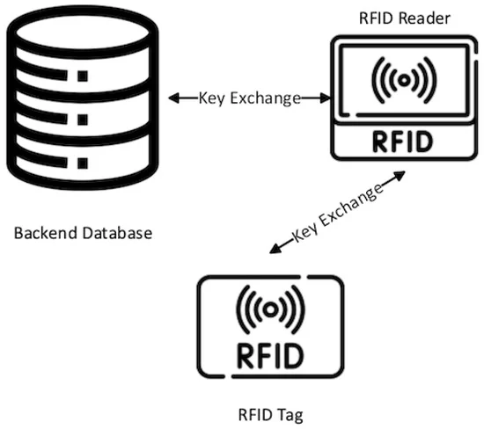
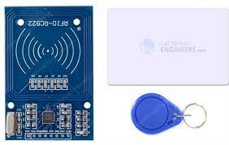
RFID – Radio Frequency IDentificator
“Radio Frequency Identification (RFID) technology uses radio waves to identify people or objects. There is a device that reads information contained in a wireless device or “tag” from a distance without making any physical contact or requiring a line of sight.”
https://www.google.com/url?sa=i&url=https%3A%2F%2Fwww.mdpi.com%2F2079-9292%2F12%2F13%2F2990&psig=AOvVaw2IlLs-M8552zVatMBwbNTY&ust=1709840435276000&source=images&cd=vfe&opi=89978449&ved=0CBUQjhxqFwoTCNDMjJuy4IQDFQAAAAAdAAAAABAD
https://www.dhs.gov/radio-frequency-identification-rfid-what-it#:~:text=policy%20or%20programs.-,Radio%20Frequency%20Identification%20(RFID)%3A%20What%20is%20it%3F,requiring%20a%20line%20of%20sight.

Slide 2
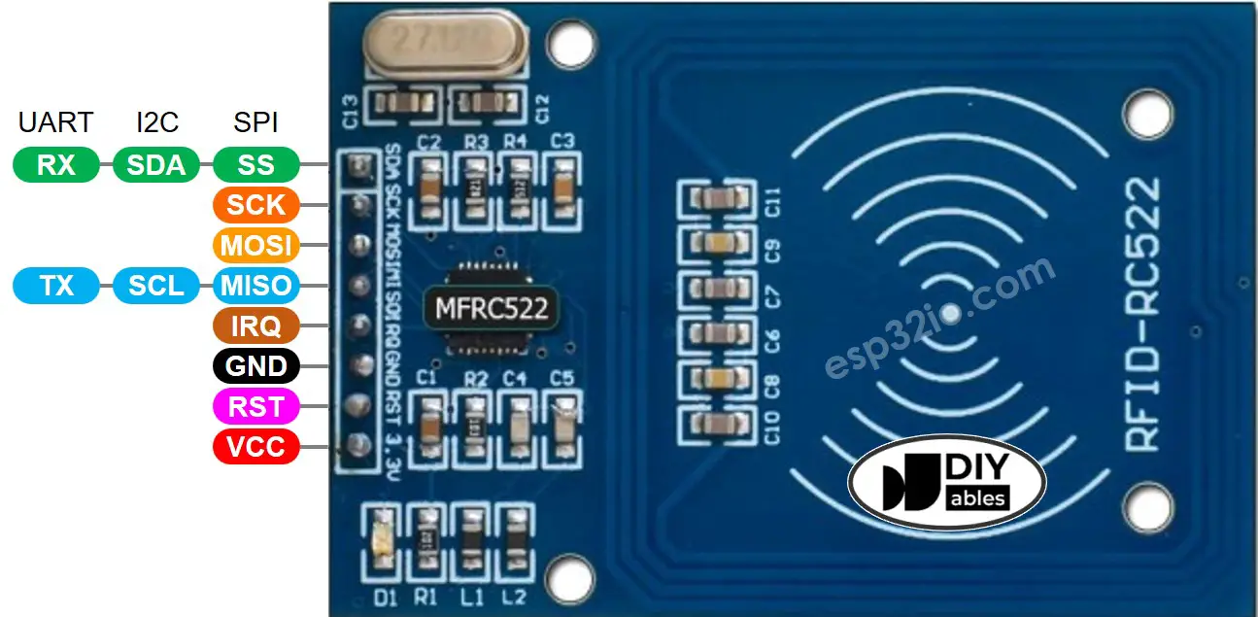
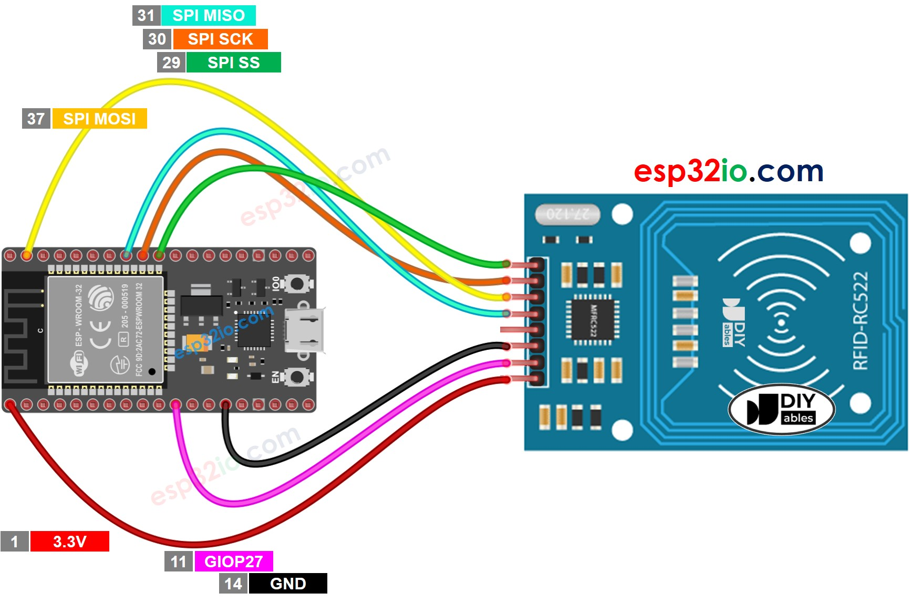
RFID – Wiring diagram and code – RFID detection
/*
* This ESP32 code is created by esp32io.com
*
* This ESP32 code is released in the public domain
*
* For more detail (instruction and wiring diagram), visit https://esp32io.com/tutorials/esp32-rfid-nfc
*/
#include <SPI.h>
#include <MFRC522.h>
#define SS_PIN 5 // ESP32 pin GPIO5
#define RST_PIN 27 // ESP32 pin GPIO27
MFRC522 rfid(SS_PIN, RST_PIN);
void setup() {
Serial.begin(9600);
SPI.begin(); // init SPI bus
rfid.PCD_Init(); // init MFRC522
Serial.println("Tap an RFID/NFC tag on the RFID-RC522 reader");
}
void loop() {
if (rfid.PICC_IsNewCardPresent()) { // new tag is available
if (rfid.PICC_ReadCardSerial()) { // NUID has been readed
MFRC522::PICC_Type piccType = rfid.PICC_GetType(rfid.uid.sak);
Serial.print("RFID/NFC Tag Type: ");
Serial.println(rfid.PICC_GetTypeName(piccType));
// print UID in Serial Monitor in the hex format
Serial.print("UID:");
for (int i = 0; i < rfid.uid.size; i++) {
Serial.print(rfid.uid.uidByte[i] < 0x10 ? " 0" : " ");
Serial.print(rfid.uid.uidByte[i], HEX);
}
Serial.println();
rfid.PICC_HaltA(); // halt PICC
rfid.PCD_StopCrypto1(); // stop encryption on PCD
}
}
}
https://esp32io.com/tutorials/esp32-rfid-nfc

Slide 3
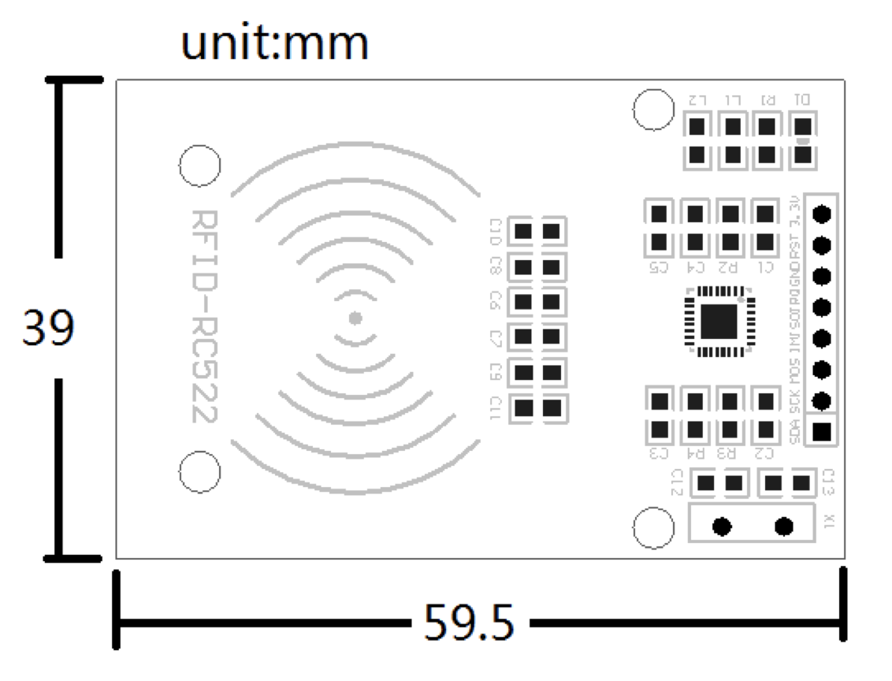
RFID module – Data specs
http://www.handsontec.com/dataspecs/RC522.pdf

Slide 4
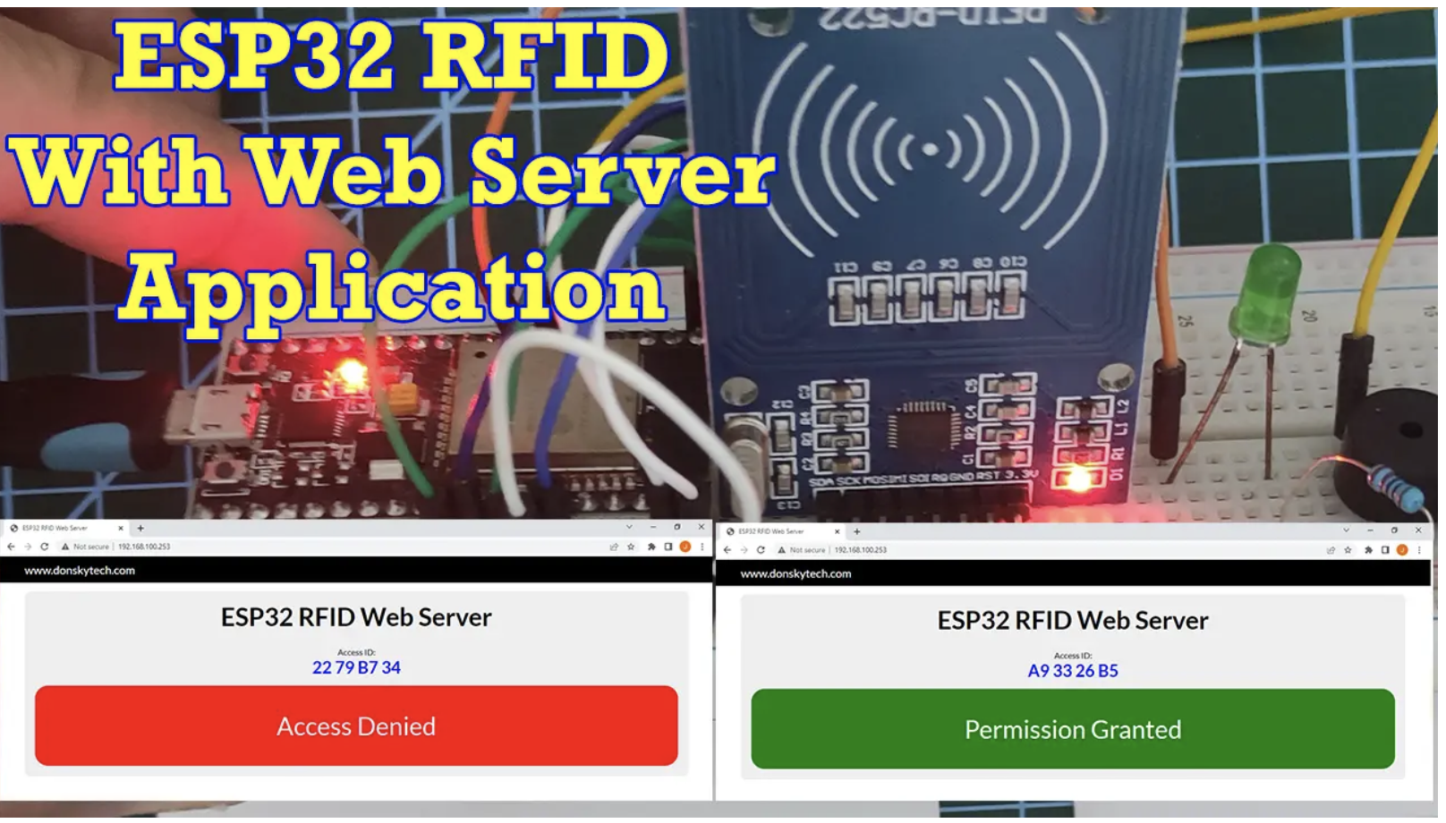
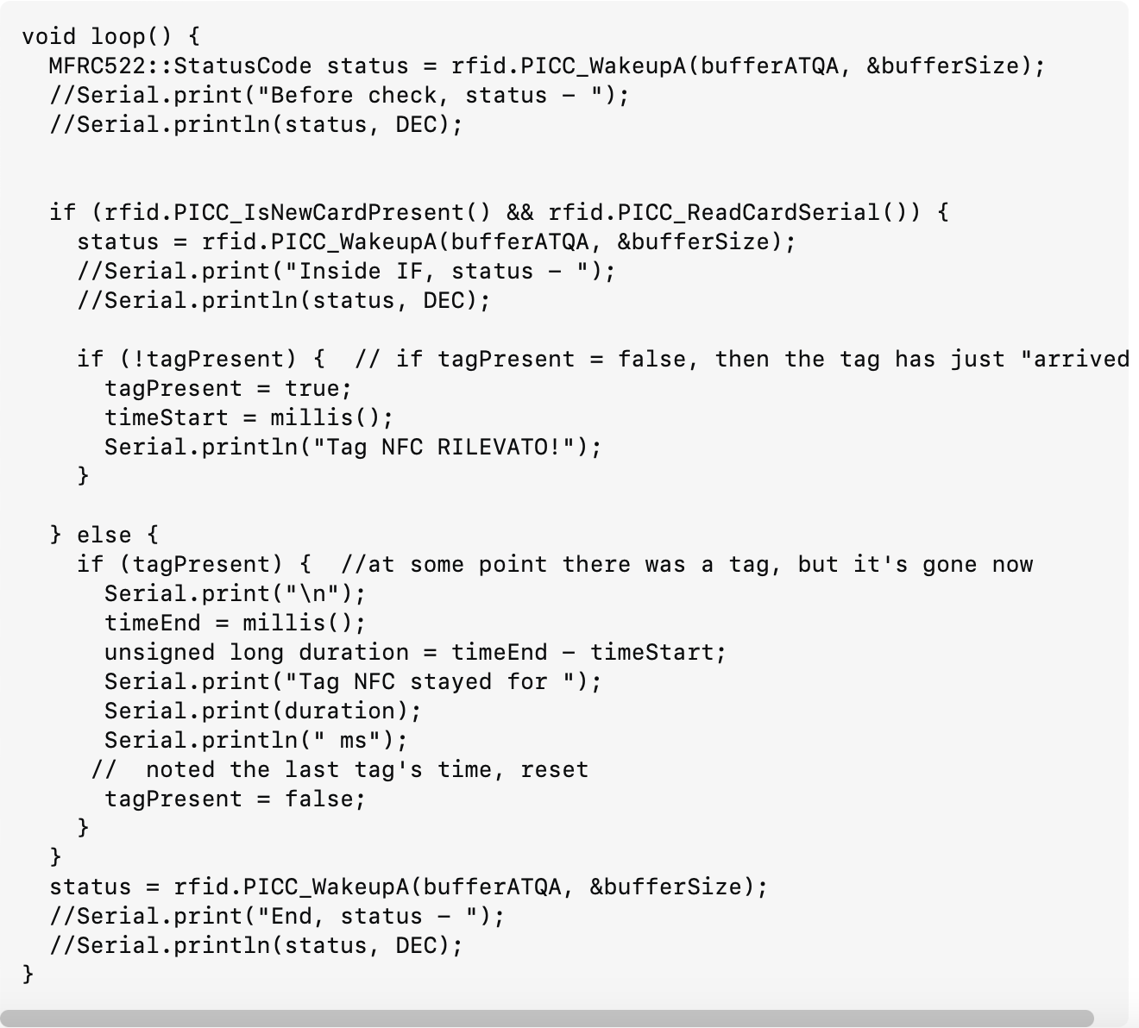
Future work
Adapt the code from this example
Implement this code to check the time the rabbit stays on carrots
https://www.donskytech.com/esp32-rfid-web-server/
https://stackoverflow.com/questions/77106785/measure-how-much-time-an-nfc-tag-stays-on-rc522

Slide 5
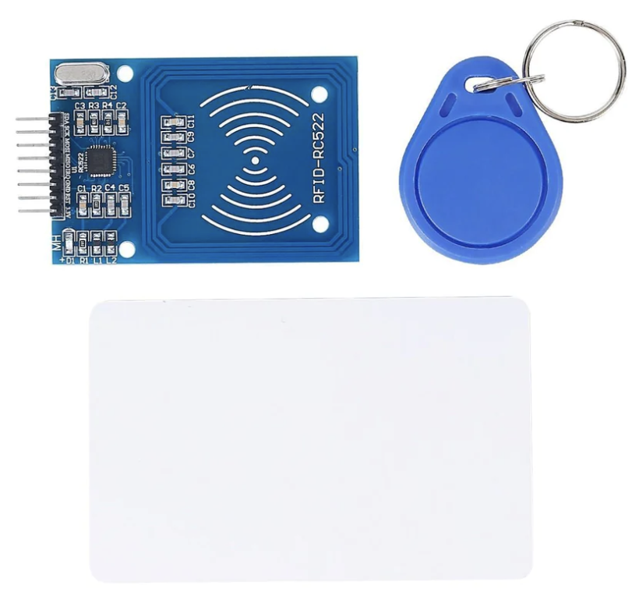


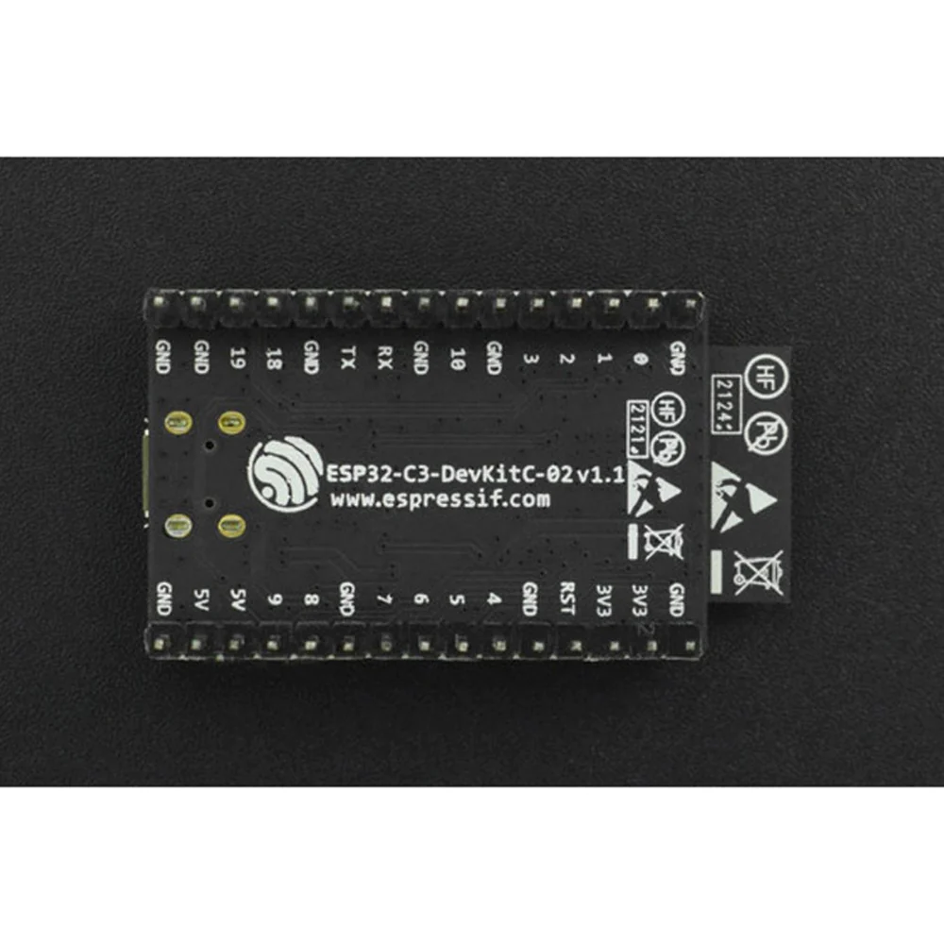
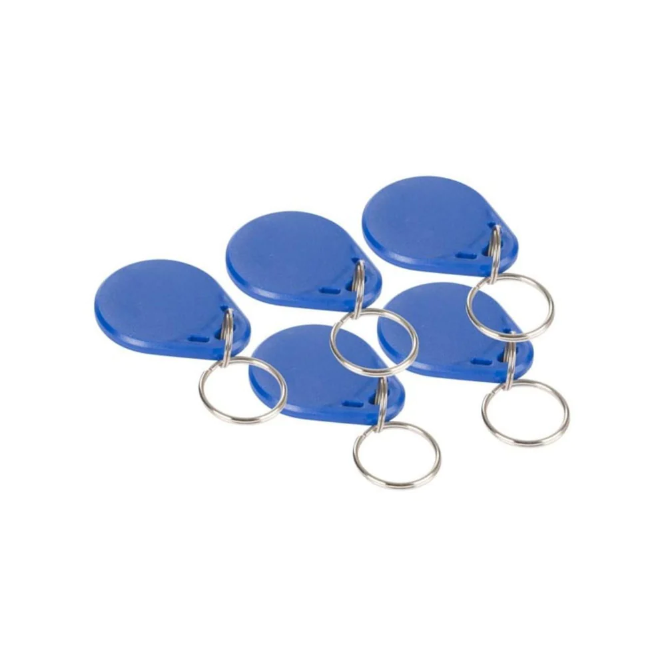
Required Components
# | Component | Qty | Price
1 | Mifare RC522 Module RFID Reader | 1 | 9.90
2 | ESP32-C3-DevKitC-02 Development Board | 1 | 14.90
3 | 13.5 MHz RFID Tag - Key Fob (5pk) | 1 | 4.49
 |  | Total | 29.29
1.
2.
3.

Slide 6
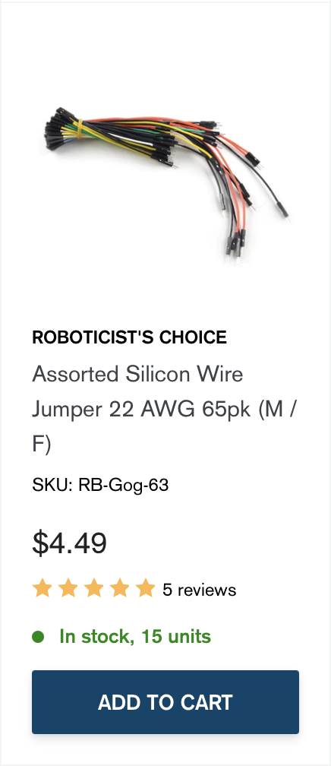
Extra Components
Jumper wires?

Slide 7
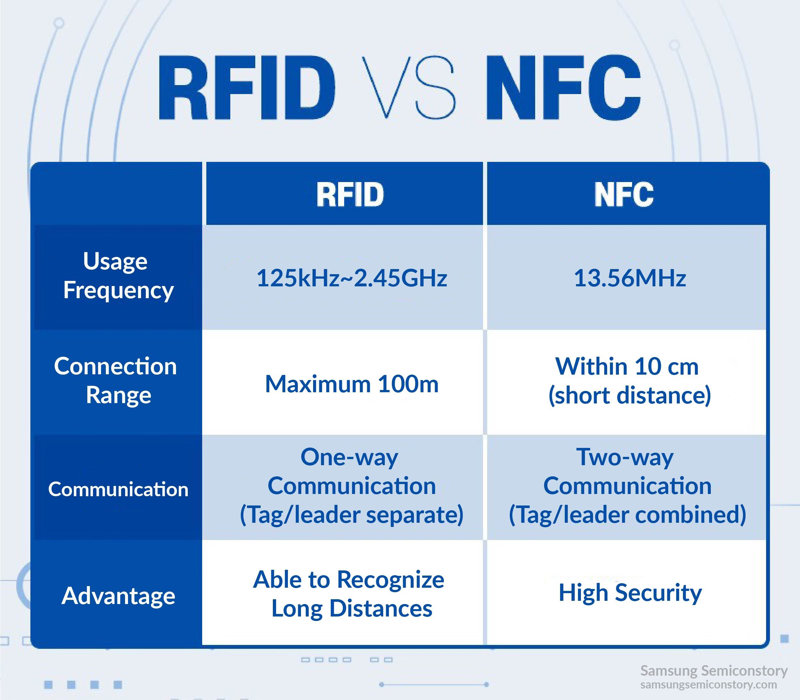
Notes:
https://semiconductor.samsung.com/news-events/tech-blog/wireless-technology-to-transform-the-world-part2-rfid-steady-player-of-radio-frequency-technology/

